Slide 1
Network protocols and vulnerabilities

Slide 2
IPv4 and IPv6
IP was designed as a Layer 3 connectionless protocol. It provides the necessary functions to deliver a packet from a source host to a destination host over an interconnected system of networks.
IP makes no effort to validate whether the source IP address contained in a packet actually came from that source. For this reason, threat actors can send packets using a spoofed source IP address.
Also, threat actors can tamper with the other fields in the IP header to carry out their attacks. So, it is important for security analysts to understand the different fields in both the IPv4 and IPv6 headers.

Slide 3
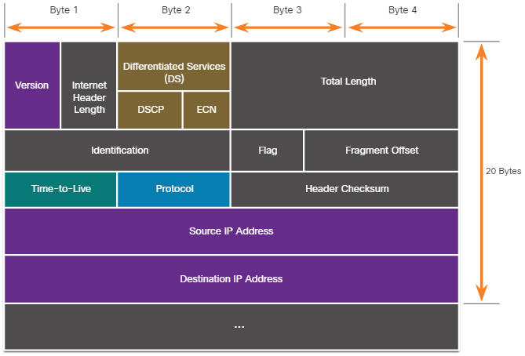
The IPv4 Packet Header
The fields in the IPv4 packet header are shown in the figure. There are 10 fields in the IPv4 packet header.

Slide 4
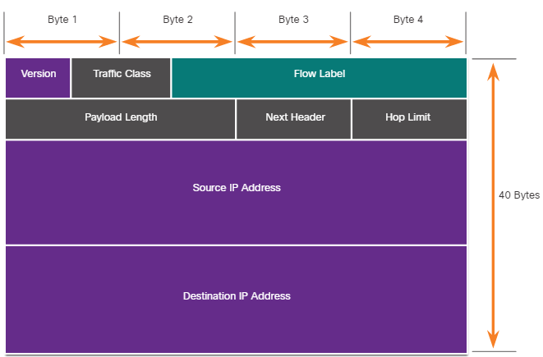
The IPv6 Packet Header
There are eight fields in the IPv6 packet header, as shown in the figure.

Slide 5
IP Vulnerabilities IP Vulnerabilities
The following table lists some of the common IP-related attacks:
IP Attacks | Description
ICMP attacks | Threat actors use Internet Control Message Protocol (ICMP) echo packets (pings) to discover subnets and hosts on a protected network, to generate DoS flood attacks, and to alter host routing tables.
DoS attacks | Threat actors attempt to prevent legitimate users from accessing information or services.
DDoS attacks | Similar to a DoS attack, but features a simultaneous, coordinated attack from multiple source machines.
Address spoofing attacks | Threat actors spoof the source IP address in an attempt to perform blind spoofing or non-blind spoofing.
Man-in-the-middle attack (MiTM) | Threat actors position themselves between a source and destination to transparently monitor, capture, and control the communication. They could simply eavesdrop by inspecting captured packets or alter packets and forward them to their original destination.
Session hijacking | Threat actors gain access to the physical network, and then use an MiTM attack to hijack a session.

Slide 6
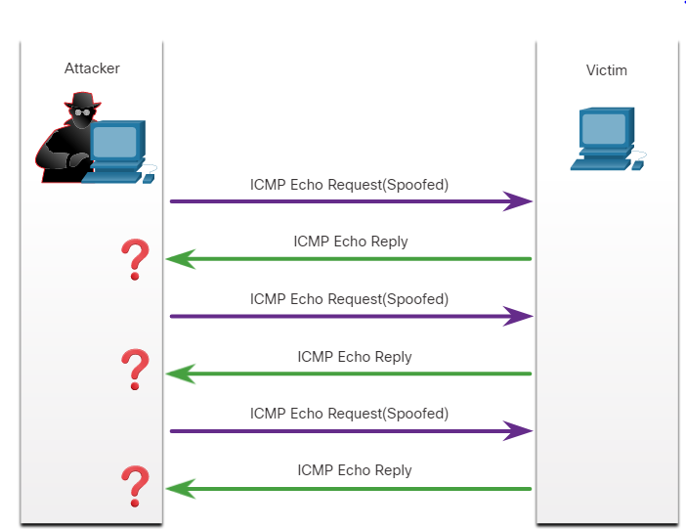
IP Vulnerabilities ICMP Attacks
ICMP was developed to carry diagnostic messages and to report error conditions when routes, hosts, and ports are unavailable. ICMP messages are generated by devices when a network error or outage occurs.
The ping command is a user-generated ICMP message, called an echo request, that is used to verify connectivity to a destination.
Threat actors use ICMP for reconnaissance and scanning attacks.
Threat actors also use ICMP for DoS and DDoS attacks, as shown in the ICMP flood attack in the figure.
Note: ICMP for IPv4 (ICMPv4) and ICMP for IPv6 (ICMPv6) are susceptible to similar types of attacks.

Slide 7
IP Vulnerabilities ICMP Attacks (Contd.)
Networks should have strict ICMP access control list (ACL) filtering on the network edge to avoid ICMP probing from the internet.
The following table lists the common ICMP messages of interest to threat actors.
ICMP Message | Description
ICMP echo request and echo reply | This is used to perform host verification and DoS attacks.
ICMP unreachable | This is used to perform network reconnaissance and scanning attacks.
ICMP mask reply | This is used to map an internal IP network.
ICMP redirects | This is used to lure a target host into sending all traffic through a compromised device and create a MITM attack.
ICMP router discovery | This is used to inject bogus route entries into the routing table of a target host.

Slide 8
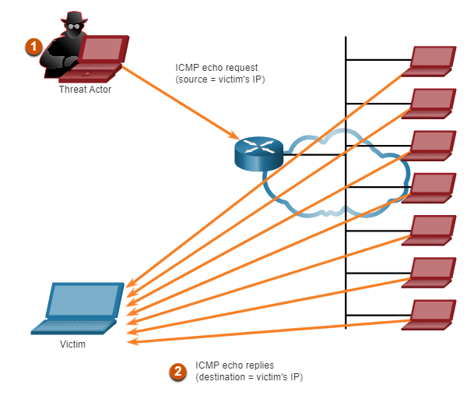
IP Vulnerabilities Amplification and Reflection Attacks
Threat actors often use amplification and reflection techniques to create DoS attacks.
The figure shows how an amplification and reflection technique called a Smurf attack is used to overwhelm a target host.
Amplification - The threat actor forwards ICMP echo request messages to many hosts. These messages contain the source IP address of the victim.
Reflection - These hosts all reply to the spoofed IP address of the victim to overwhelm it.
Threat actors also use resource exhaustion attacks.
Note: Newer forms of amplification and reflection attacks such as DNS-based reflection and amplification attacks and Network Time Protocol (NTP) amplification attacks are now being used.

Slide 9
IP Vulnerabilities Address Spoofing Attacks
IP address spoofing attacks occur when a threat actor creates packets with false source IP address information to either hide the identity of the sender, or to pose as another legitimate user.
The threat actor can then gain access to otherwise inaccessible data or circumvent security configurations.
Spoofing is usually incorporated into another attack such as a Smurf attack.

Slide 10
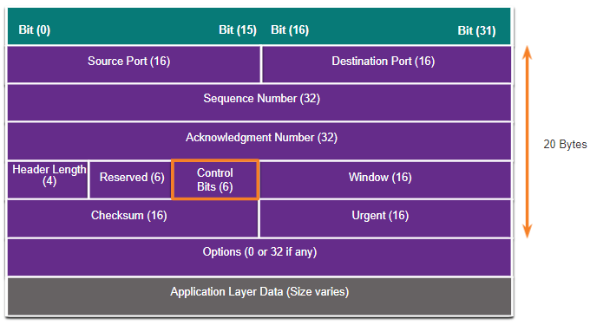
TCP and UDP Vulnerabilities TCP Segment Header
TCP segment information appears immediately after the IP header. The fields of the TCP segment and the flags for the Control Bits field are displayed in the figure.
The following are the six control bits of the TCP segment:
URG - Urgent pointer field significant
ACK - Acknowledgment field significant
PSH - Push function
RST- Reset the connection
SYN - Synchronize sequence numbers
FIN - No more data from sender

Slide 11
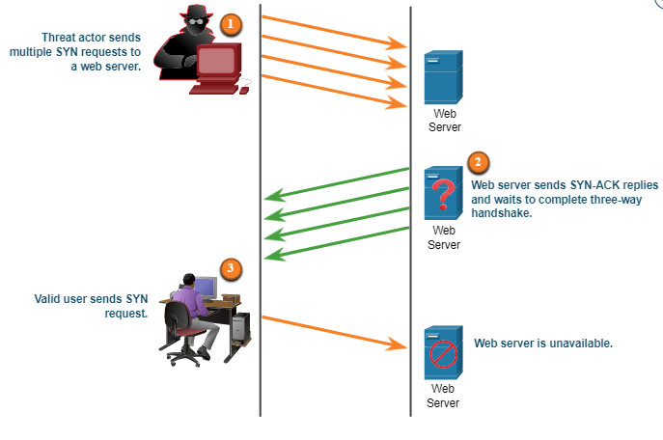
TCP and UDP Vulnerabilities TCP Attacks
Network applications use TCP or UDP ports. Threat actors conduct port scans of target devices to discover which services they offer.
TCP SYN Flood Attack
The TCP SYN Flood attack exploits the TCP three-way handshake.
The figure shows a threat actor continually sending TCP SYN session request packets with a randomly spoofed source IP address to a target.
The target replies with a TCP SYN-ACK packet to the spoofed IP address and waits for a TCP ACK packet. Those responses never arrive.
The target host has too many half-open TCP connections, and TCP services are denied to legitimate users.

Slide 12
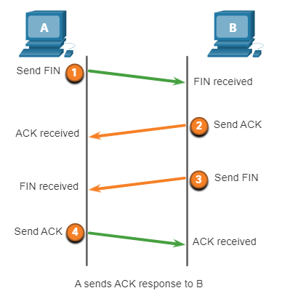
TCP and UDP Vulnerabilities TCP Attacks (Contd.)
TCP Reset Attack
A TCP reset attack can be used to terminate TCP communications between two hosts.
A threat actor could do a TCP reset attack and send a spoofed packet containing a TCP RST to one or both endpoints.
Terminating a TCP session uses the following four-way exchange process:
When the client has no more data to send in the stream, it sends a segment with the FIN flag set.
The server sends an ACK to acknowledge the receipt of the FIN to terminate the session from client to server.
The server sends a FIN to the client to terminate the server-to-client session.
The client responds with an ACK to acknowledge the FIN from the server.

Slide 13
TCP and UDP Vulnerabilities TCP Attacks (Contd.)
TCP Session Hijacking
TCP session hijacking is another TCP vulnerability.
A threat actor takes over an already-authenticated host as it communicates with the target.
The threat actor must spoof the IP address of one host, predict the next sequence number, and send an ACK to the other host.
If successful, the threat actor could send, but not receive, data from the target device.

Slide 14
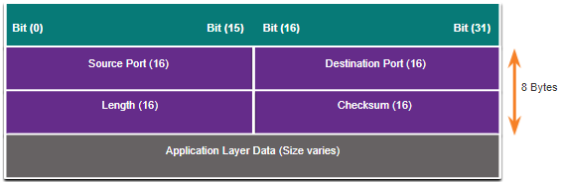
TCP and UDP Vulnerabilities UDP Segment Header and Operation
UDP is commonly used by DNS, DHCP, TFTP, NFS, and SNMP.
It is also used with real-time applications such as media streaming or VoIP. UDP is a connectionless transport layer protocol.
The UDP segment structure, shown in the figure, is much smaller than TCP.
The low overhead of UDP makes it very desirable for protocols that make simple request and reply transactions.
Although UDP is normally called unreliable, this does not mean that applications that use UDP are always unreliable. It means that these functions are not provided by the transport layer protocol and must be implemented elsewhere if required.

Slide 15
TCP and UDP Vulnerabilities UDP Attacks
UDP is not protected by any encryption. Encryption can be added to UDP, but it is not available by default.
The lack of encryption means that anyone can see the traffic, change it, and send it on to its destination.
UDP Flood Attacks
In a UDP flood attack, all the resources on a network are consumed.
The threat actor must use a tool like UDP Unicorn or Low Orbit Ion Cannon. These tools send a flood of UDP packets, often from a spoofed host, to a server on the subnet.
The program will sweep through all the known ports trying to find closed ports. This will cause the server to reply with an ICMP port unreachable message.
As there are many closed ports on the server, this creates a lot of traffic on the segment, which uses up most of the bandwidth. The result is very similar to a DoS attack.

Slide 16
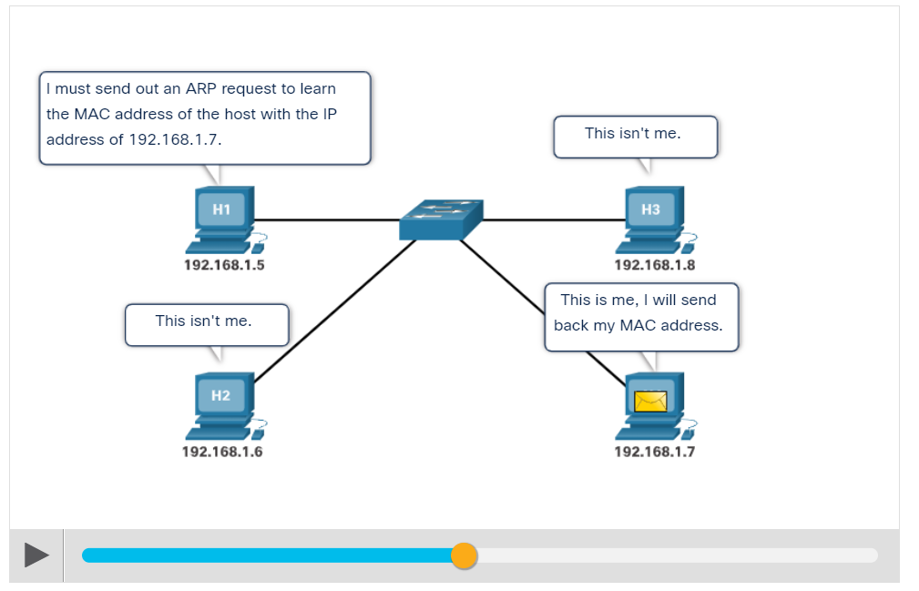
ARP Vulnerabilities
Hosts broadcast an ARP Request to other hosts on the network segment to determine the MAC address of a host with a particular IP address.
The host with the matching IP address in the ARP Request sends an ARP Reply called “gratuitous ARP.”
A threat actor can poison the ARP cache of devices on the local network
The goal is to associate the threat actor’s MAC address with the IP address of the default gateway in the ARP caches of hosts on the LAN segment.

Slide 17
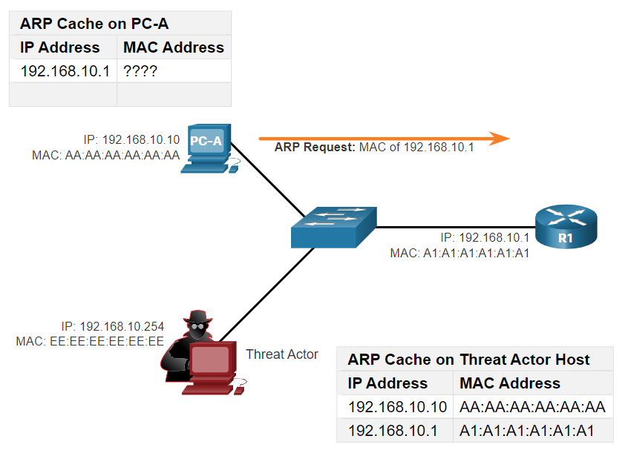
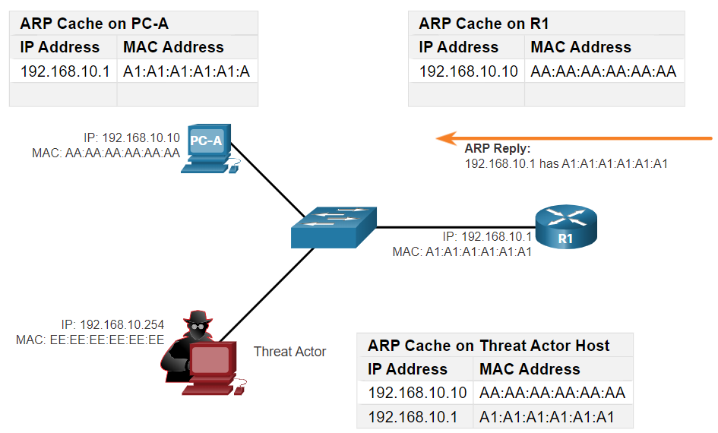
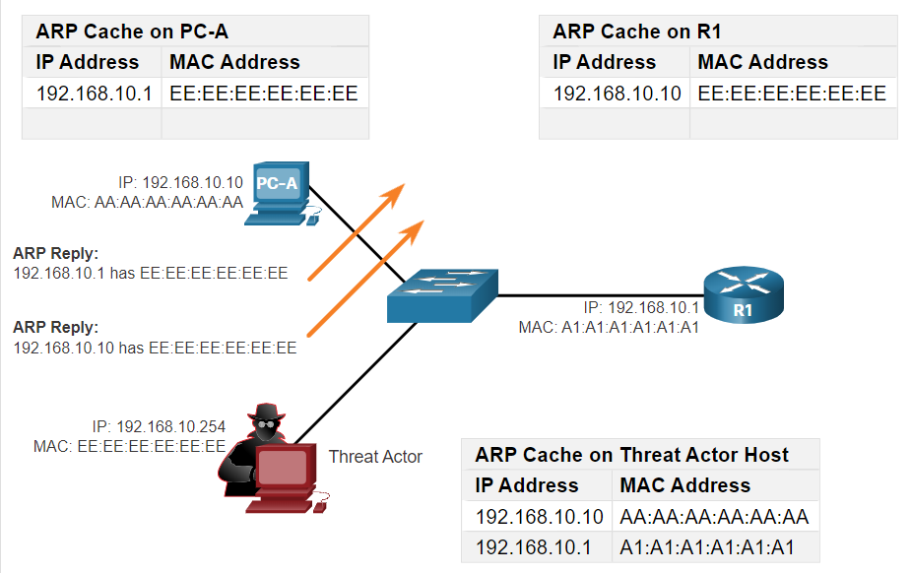
ARP Cache Poisoning
ARP cache poisoning can be used to launch various man-in-the-middle attacks.
ARP cache poisoning process
ARP Request
ARP Reply
Spoofed Gratuitous ARP replies
Note: There are many tools available on the internet to create ARP MITM attacks including dsniff, Cain & Abel, ettercap, Yersinia, and others.

Slide 18
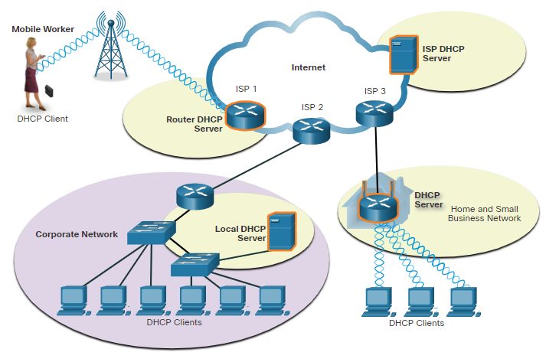
Dynamic Host Configuration Protocol
Two types of addressing:
Dynamic – Dynamic Host Configuration Protocol (DHCP) for IPv4 service automates the assignment of IPv4 addresses, subnet masks, gateways, and other IPv4 networking parameters.
Static – The network administrator manually enters IP address information on hosts.
When a host connects to the network, the DHCP server chooses an address from a configured range of addresses called a pool and assigns it to the host.
DHCP can allocate IP addresses for a configurable period of time, called a lease period.
Medium-to-large networks – DHCP server is a local PC-based server
Home network – DHCP server is on the local router connecting the home network to the ISP.

Slide 19
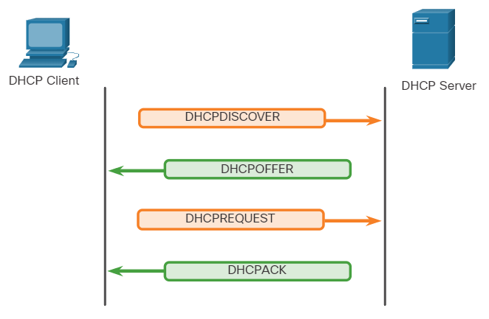
DHCP Operation
DHCP operation includes: DHCPDISCOVER, DHCPOFFER, DHCPREQUEST, DHCPACK, and DHCPNAK.
When DHCP-configured device connects to the network, the client broadcasts a DHCPDISCOVER message to identify any available DHCP servers on the network.
A DHCP server replies with a DHCPOFFER message, which offers a lease to the client.
The client sends a DHCPREQUEST message that identifies the explicit server and lease offer that the client is accepting.
If the IPv4 address requested by the client, or offered by the server, is still available, the server returns the DHCPACK message. If the offer is no longer valid, then the selected server responds with a DHCPNAK message. If a DHCPNAK message is returned, then the selection process begins again with a new DHCPDISCOVER message being transmitted.

Slide 20
DHCP Attacks
DHCP Spoofing Attack
A DHCP spoofing attack occurs when a rogue DHCP server is connected to the network and provides false IP configuration parameters to legitimate clients.
A rogue server can provide a variety of misleading information such as:
Wrong default gateway - Threat actor provides an invalid gateway, or the IP address of its host to create a MITM (Man In The Middle) attack.
Wrong DNS server - Threat actor provides an incorrect DNS server address pointing the user to a malicious website.
Wrong IP address - Threat actor provides an invalid IP address, invalid default gateway IP address, or both. The threat actor then creates a DoS attack on the DHCP client.

Slide 21
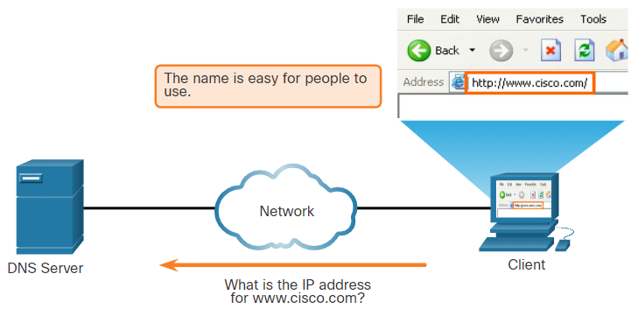
DNS
DNS Overview
Domain Name System (DNS) provides domain names and their associated IP addresses.
The DNS system consists of a global hierarchy of distributed servers that contain databases of name to IP address mappings.
The client computer in the figure will send a request to the DNS server to get the IP address for www.cisco.com so that it can address packets to that server.
Malicious DNS traffic can be detected through protocol analysis and the inspection of DNS monitoring information.
DNS Resolves Names to IP Addresses

Slide 22
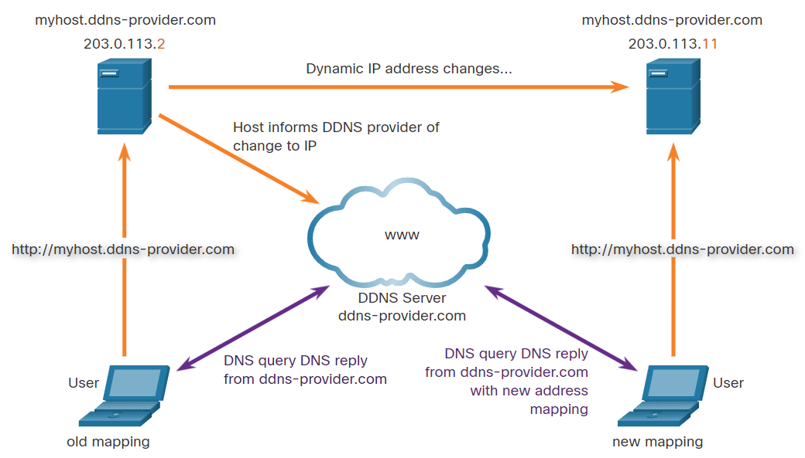
DNS
Dynamic DNS
Dynamic DNS (DDNS) allows a user or organization to register an IP address with a domain name as in DNS.
The subdomain is mapped to the IP address of the user’s server, or home router connection to the internet.
When a change is detected, the DDNS provider is immediately informed of the change and the mapping between the user’s subdomain and the internet IP address is immediately updated.
The DDNS provider service supplies that IP address to the resolver’s second level DNS server. This DNS server, either at the organization or ISP, provides the DDNS IP address to the resolver.

Slide 23
DNS Attacks
DNS attacks include the following:
DNS open resolver attacks:
A DNS open resolver is a publicly open DNS server such as Google DNS (8.8.8.8) that answers client’s queries outside its administrative domain. DNS open resolvers are vulnerable to multiple malicious activities described in the table.
DNS Resolver Vulnerabilities | Description
DNS cache poisoning attacks | Threat actors send spoofed, falsified Record Resource (RR) information to a DNS resolver to redirect users from legitimate sites to malicious sites.
DNS amplification and reflection attacks | Threat actors send DNS messages to the open resolvers using the IP address of a target host.
DNS resource utilization attacks | This DoS attack consumes all the available resources to negatively affect the operations of the DNS open resolver.

Slide 24
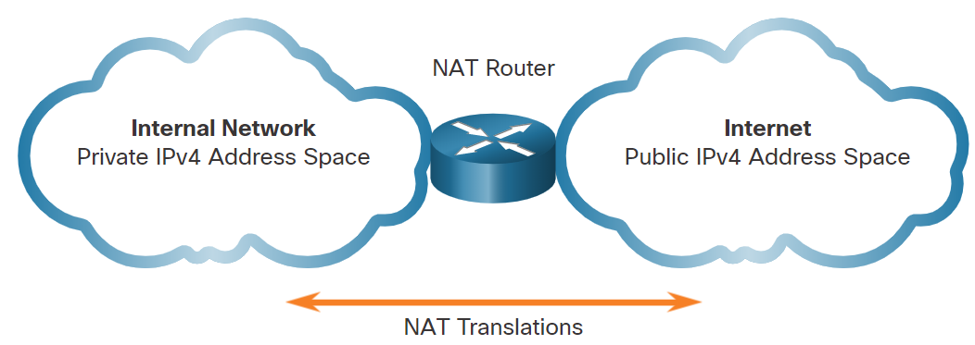
NAT
IPv4 Private Address Space
To allow a device with a private IPv4 address to access devices and resources outside the local network, the private address must be translated to a public address.
NAT provides the translation of private addresses to public addresses.
A single, public IPv4 address can be shared by thousands of devices, each configured with a unique private IPv4 address.
The solution to the exhaustion of IPv4 address space and the limitations of NAT is the eventual transition to IPv6.

Slide 25
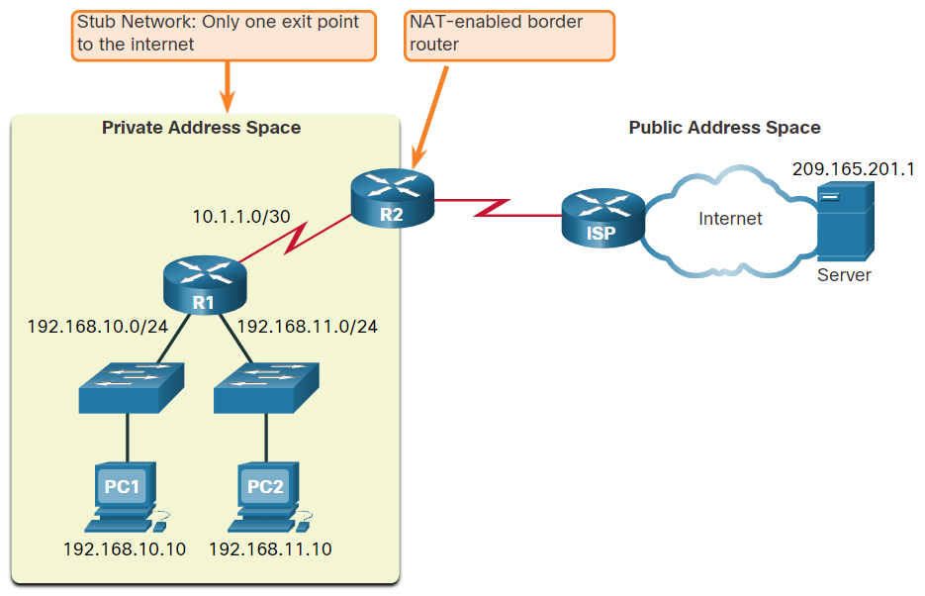
NAT
What is NAT?
NAT is used to conserve public IPv4 addresses.
NAT-enabled routers can be configured with one or more valid public IPv4 addresses which are known as the NAT pool.
A NAT router typically operates at the border of a stub network.
When a device inside the stub network wants to communicate with a device outside its network, the packet is forwarded to the border router and the router performs the NAT process.
Note: The connection to the ISP may use a private address or a public address that is shared among customers. For the purposes of this module, a public address is shown.

Slide 26
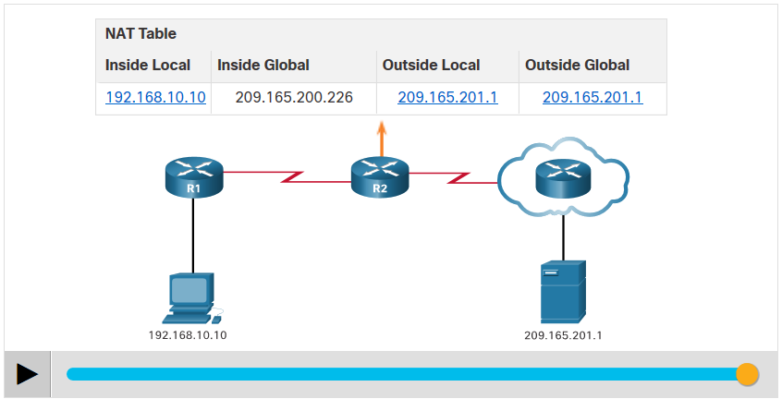
NAT
How NAT works?
In this example, PC1 with private address 192.168.10.10 wants to communicate with an outside web server with public address 209.165.201.1.
Click the Play button in the figure to view the animation.

Slide 27
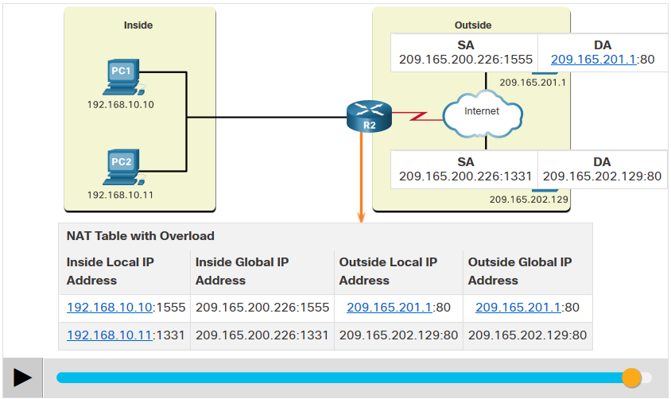
NAT
Port Address Translation
Port Address Translation (PAT), also known as NAT overload, maps multiple private IPv4 addresses to a single public IPv4 address or a few addresses.
When a device initiates a TCP/IP session, it generates a TCP or UDP source port value, or a specially assigned query ID for ICMP, to uniquely identify the session.
PAT ensures that devices use a different TCP port number for each session with a server on the internet.
PAT adds unique source port numbers to the inside global address to distinguish between translations.

Slide 28
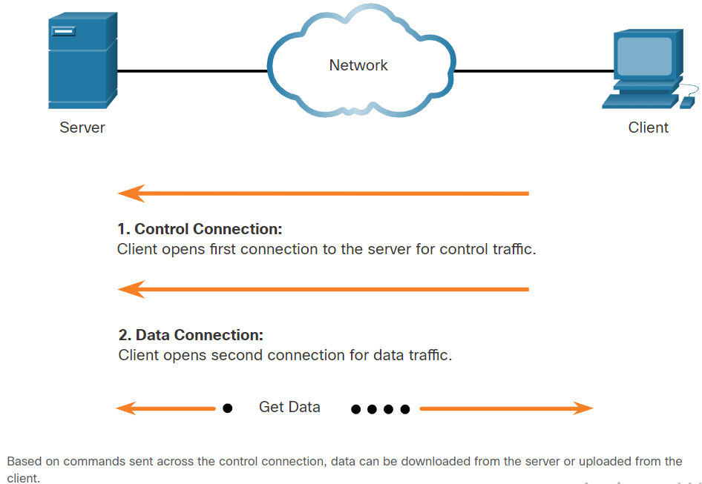
File Transfer and Sharing Services
FTP and TFTP
FTP allows data transfers between a client and a server.
An FTP client runs on a computer and is used to push and pull data from an FTP server.
FTP connections between the client and server:
Control Connection: The client opens the first connection to the server for control traffic.
Data Connection: The client opens the second connection to the server for data traffic.
Trivial File Transfer Protocol (TFTP) is a simplified file transfer protocol that uses well-known UDP port number 69.

Slide 29
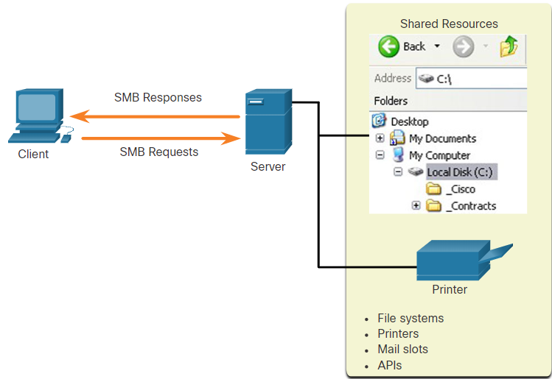
File Transfer and Sharing Services
SMB
The Server Message Block (SMB) is a client/server file sharing protocol that describes the structure of shared network resources.
SMB is a client/server, request-response protocol.
Servers can make their own resources available to clients on the network.

Slide 30
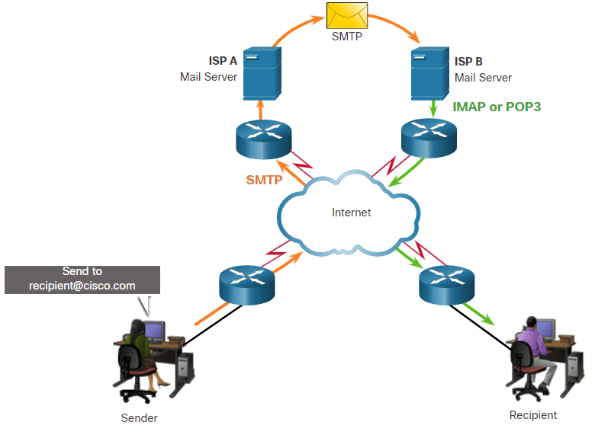
Email
Email protocols
Email is a store-and-forward method of sending, storing, and retrieving electronic messages across a network.
Email clients communicate with mail servers to send and receive email.
Email supports three separate protocols for operation: Simple Mail Transfer Protocol (SMTP), Post Office Protocol (POP), and IMAP.
A client retrieves email using one of the two application layer protocols: POP or IMAP.

Slide 31
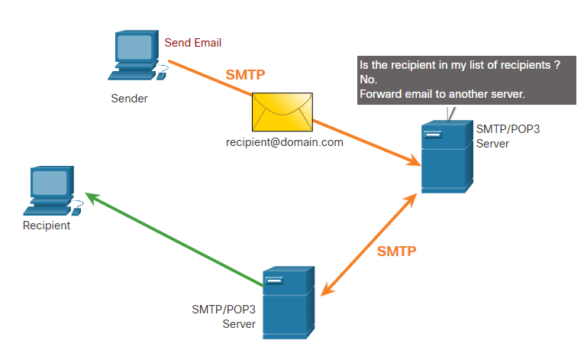
Email
SMTP
SMTP message formats require a message header and a message body.
When a client sends an email, the client SMTP process connects with a server SMTP process on a well-known port 25.
When the server receives the message, it either places the message in a local account, if the recipient is local, or forwards the message to another mail server for delivery.
Periodically, the server checks the queue for messages and attempts to send them again. If the message is still not delivered after a predetermined expiration time, it is returned to the sender as undeliverable.

Slide 32
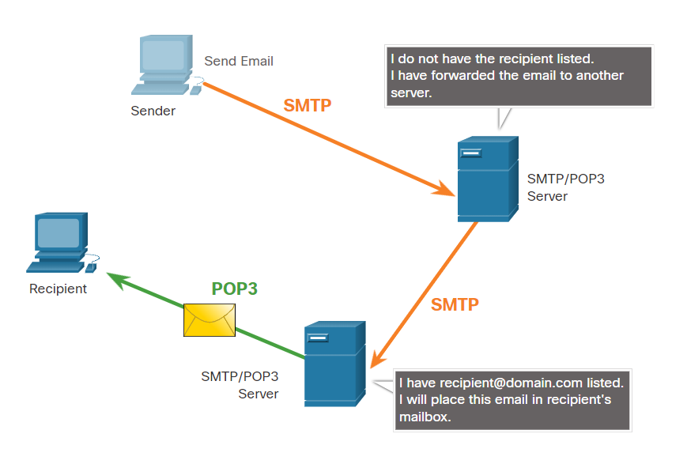
Email
POP3
POP3 is used by an application to retrieve a mail from a mail server.
With POP3, email messages are downloaded to the client and removed from the server.
The server starts the POP3 service by passively listening on TCP port 110 for client connection requests.
The client sends a request to establish a TCP connection with the server.
Once the connection is established, the POP3 server sends a greeting. The client and POP3 server then exchange commands and responses until the connection is closed or aborted.

Slide 33
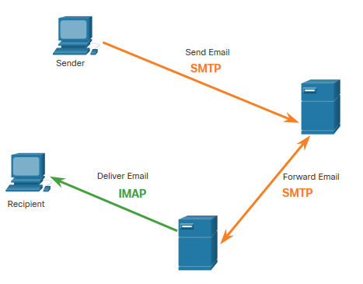
Email
IMAP
IMAP is the protocol that describes a method to retrieve email messages.
When the user connects to an IMAP-capable server, copies of the messages are downloaded to the client application. The original messages are kept on the server until manually deleted.
Users view copies of the messages in their email client software.
Users can create a file hierarchy on the server to organize and store mail.
When a user decides to delete a message, the server synchronizes that action and deletes the message from the server.

Slide 34
Enterprise Services
Email
As the level of use of email rises, security becomes a greater priority.
The way users access email today also increases the opportunity for the threat of malware to be introduced.
Examples of email threats:
Attachment-based attacks - Threat actors embed malicious content in business files such as an email from the IT department.
Email spoofing - Threat actors create email messages with a forged sender address that is meant to fool the recipient into providing money or sensitive information.
Spam email - Threat actors send unsolicited email containing advertisements or malicious files.
Open mail relay server - This is an SMTP server that allows anybody on the internet to send mail.

Slide 35
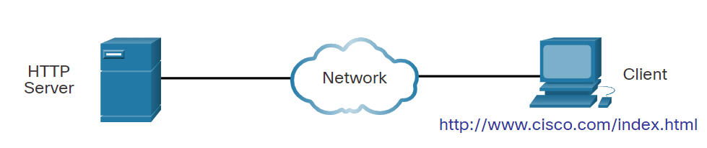
HTTP
Hypertext Transfer Protocol and Hypertext Markup Language
When a web address or Uniform Resource Locator (URL) is typed into a web browser, the web browser establishes a connection with the web service that is using the HTTP protocol.
Lets take a look on how a web page is opened in a browser. Example: http://www.cisco.com/index.html
Step 1: The browser interprets the three parts of the URL:
http (the protocol or scheme)
www.cisco.com (the server name)
index.html (the specific filename requested)

Slide 36
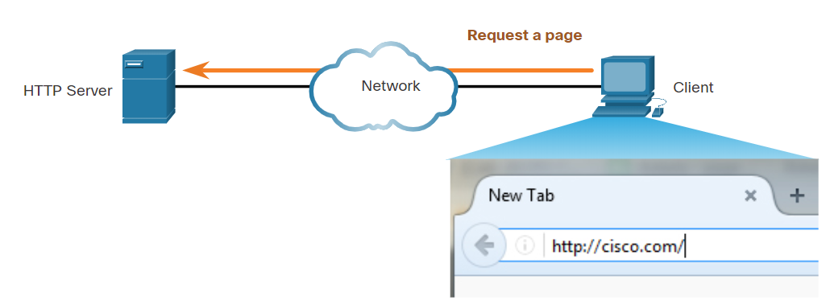
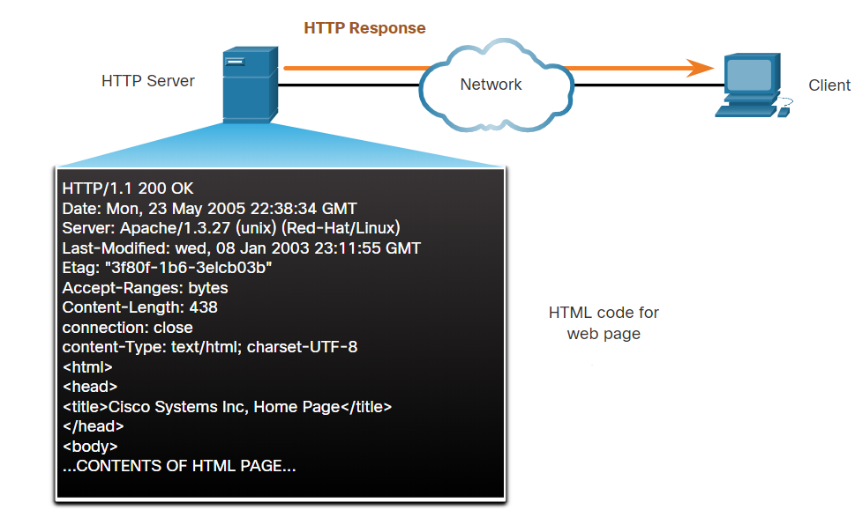
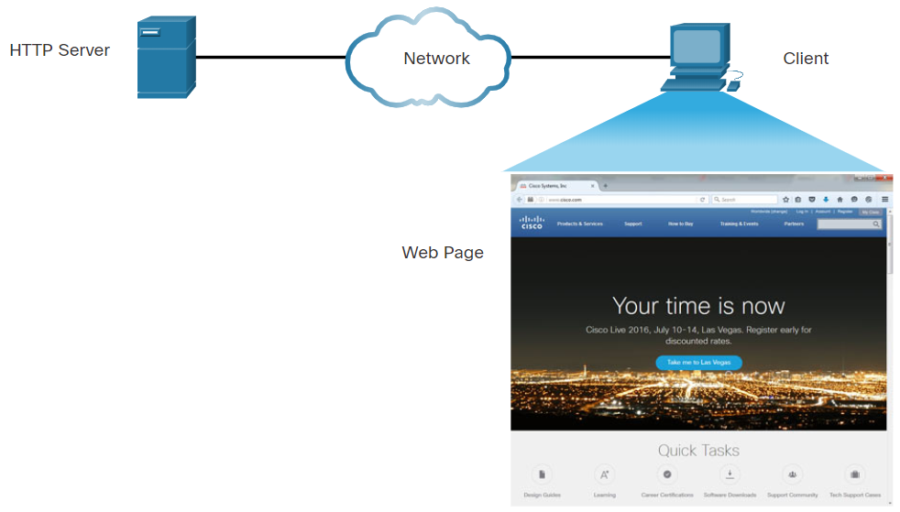
HTTP
Hypertext Transfer Protocol and Hypertext Markup Language (Contd.)
Step 2: The client initiates an HTTP request to a server by sending a GET request to the server and asks for the index.html file.
Step 3: In response to the request, the server sends the HTML code for this web page to the browser.
Step 4: The browser deciphers the HTML code and formats the page for the browser window.

Slide 37
Enterprise Services
Common HTTP Exploits
Malicious iFrames
An iFrame is an HTML element that allows the browser to load another web page from another source.
In iFrame attacks, the threat actors insert advertisements from other sources into the page.
Threat actors compromise a webserver and modify web pages by adding HTML for the malicious iFrame.
As the iFrame is running in the page, it can be used to deliver a malicious exploit. such as spam advertising, exploit kits, and other malware.
Steps to prevent or reduce malicious iFrames:
Use a web proxy like to block malicious sites.
Ensure web developers do not use iFrames.
Use a service such as Cisco Umbrella to prevent users from navigating to malicious websites.
Ensure the end user understands what an Iframe is.

Slide 38
Enterprise Services
Common HTTP Exploits (Contd.)
HTTP 302 Cushioning
Threat actors use the 302 Found HTTP response status code to direct the user’s web browser to a new location.
The browser believes that the new location is the URL provided in the header. The browser is invited to request this new URL. This redirect function can be used multiple times until the browser finally lands on the page that contains the exploit.
Steps to prevent or reduce HTTP 302 cushioning attacks:
Use a web proxy to block malicious sites.
Use a service such as Cisco Umbrella to prevent users from navigating to malicious websites.
Ensure the end user understands how the browser is redirected through a series of HTTP 302 redirections.

Slide 39
Enterprise Services
Common HTTP Exploits (Contd.)
Domain Shadowing
When a threat actor create a domain shadowing attack, first they compromise a domain. Then they must create multiple subdomains of that domain to be used for the attacks using Hijacked domain registration logins.
After these subdomains have been created, attackers can use them even if they are found out to be malicious domains. They can simply make more from the parent domain.
Steps to prevent or reduce Domain shadowing attacks:
Secure all domain owner accounts.
Use a web proxy to block malicious sites.
Use a service such as Cisco Umbrella to prevent users from navigating to web sites that are known to be malicious.
Make sure that domain owners validate their registration accounts and look for any subdomains that they have not authorized.

Slide 40
HTTP
Securing HTTP – HTTPS
For secure communication across the internet, the HTTP Secure (HTTPS) protocol is used.
HTTPS uses authentication and encryption to secure data as it travels between the client and the server.
HTTPS uses the same client request-server response process as HTTP, but the data stream is encrypted with Secure Socket Layer (SSL), or Transport Layer Security (TLS), before being transported across the network.
HTTPS/2 is specified to use HTTPS over TLS with the Application-Layer Protocol Negotiation (ALPN) extension for TLS 1.2 or newer.
Confidential information is transmitted over the Internet using HTTPS.

